Slide 1
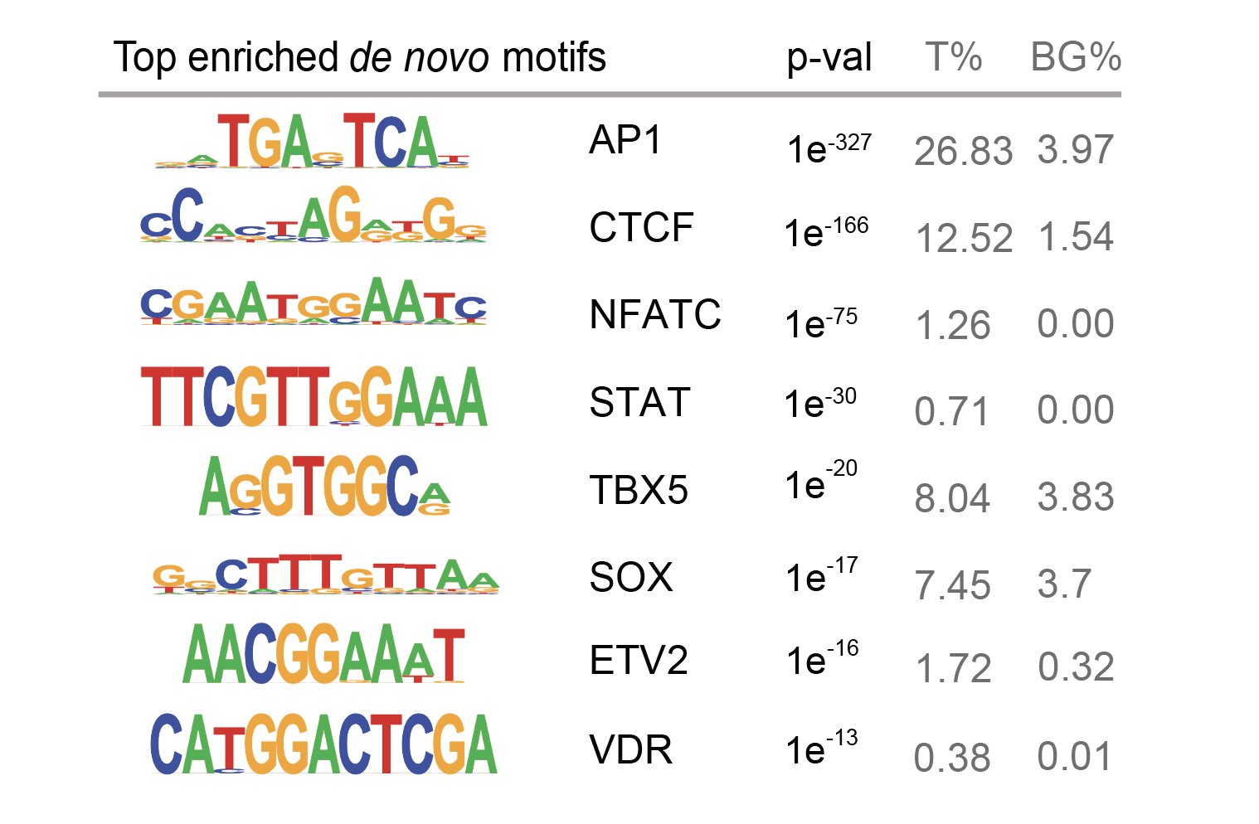
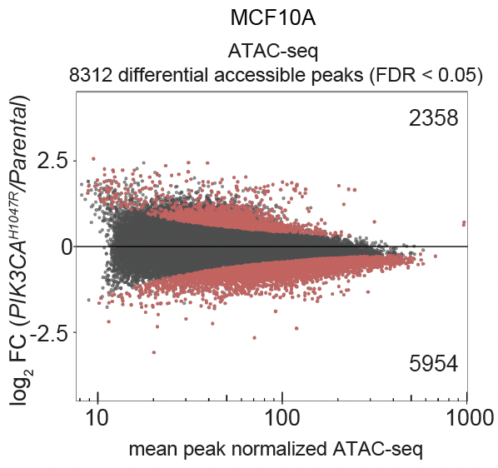
Top enriched motifs in MCF10A PIK3CA H1047R vs. parental ATAC-seq

Slide 2
Relative Expression
Relative Expression

Slide 3
Relative Expression
Relative Expression
No binding by ChIP-qPCR

